Slide 1
6 Steps Hexagonal Segmented Diagram
What is Blockchain?
A blockchain is, in the simplest of terms, a time-stamped series of immutable records of data that is managed by a cluster of computers not owned by any single entity.
Each of these blocks of data (i.e. block) is secured and bound to each other using
cryptographic principles (i.e. chain).
The blockchain network has no central authority — it is the very definition of a democratized system.
Since it is a shared and immutable ledger, the information in it is open for anyone and everyone to see.
Hence, anything that is built on the blockchain is by its very nature transparent and everyone involved is accountable for their actions.
06

Slide 2
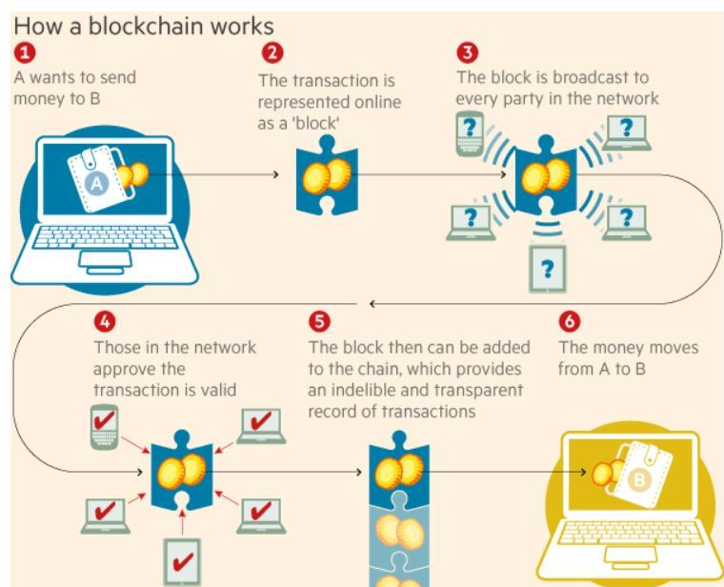

Slide 3
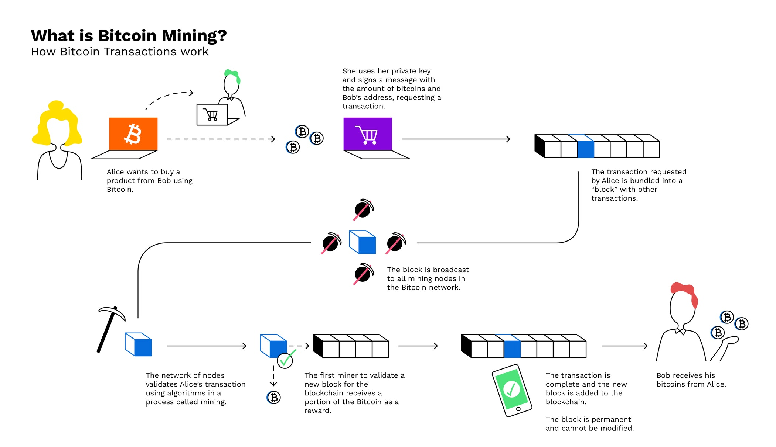

Slide 4
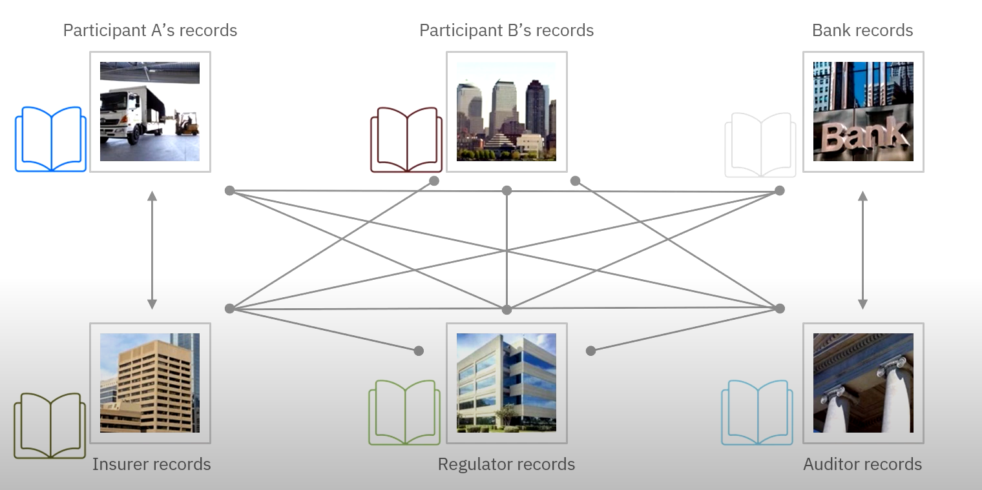
Problem

Slide 5
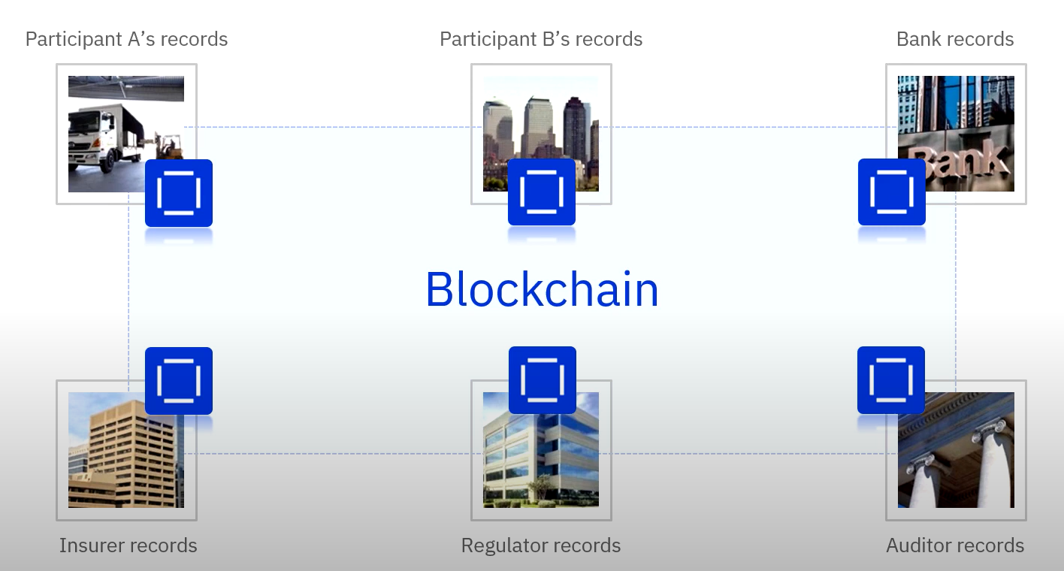
Solution

Slide 6

6 Steps Hexagonal Segmented Diagram
Bitcoin
Bitcoin is a digital currency created in January 2009 following the housing market crash.
It follows the ideas set out in a whitepaper by the mysterious and pseudonymous Satoshi Nakamoto.
Bitcoin offers the promise of lower transaction fees than traditional online payment mechanisms and is
operated by a decentralized authority, unlike government-issued currencies.
There are no physical bitcoins, only balances kept on a public ledger that everyone has transparent access to,
that – along with all Bitcoin transactions – is verified by a massive amount of computing power.

Slide 7
6 Steps Hexagonal Segmented Diagram
Consensus Algorithms
A consensus algorithm is like Bitcoin’s PoW (Proof-of-Work), which requires miners to solve complex cryptographic mathematical puzzles for which they get rewarded with certain amount of Bitcoins.
It is important to understand that each block which is added to the network must follow a set of consensus rules.
E.g. Bitcoin’s consensus rules are no double spending, correct format of blocks, a certain amount of reward for miners etc.
Blocks that fail to follow these consensus rules will be rejected.
A blend of PoW consensus algorithms and the consensus rules offers a strong and reliable network which is secure and ensures that all the nodes in the network agree on a regular global state of the blockchain.
06

Slide 8
6 Steps Hexagonal Segmented Diagram
Consensus Algorithms
Proof of Work (PoW):
This consensus algorithm is used to select a miner for the next block generation. Bitcoin uses this PoW consensus algorithm.
The central idea behind this algorithm is to solve a complex mathematical puzzle and easily give out a solution.
This mathematical puzzle requires a lot of computational power and thus, the node who solves the puzzle as soon as possible gets to mine the next block.
Practical Byzantine Fault Tolerance(pBFT):
Practical Byzantine Fault Tolerance is a consensus algorithm designed to work efficiently in
asynchronous(no upper bound on when the response to the request will be received) systems.
It is optimized for low overhead time.
It’s goal was to solve many problems associated with already available Byzantine Fault Tolerance solutions. Application areas include distributed computing and blockchain.

Slide 9
6 Steps Hexagonal Segmented Diagram
Bitcoin Monetary Policy
Proof of Stake (PoS):
This is the most common alternative to PoW.
Ethereum has shifted from PoW to PoS consensus.
Here instead of investing in expensive hardware to solve a complex puzzle, validators invest in the coins of the system by locking up some of their coins as stake.
After that, all the validators will start validating the blocks.
Proof of Burn (PoB):
With PoB, instead of investing into expensive hardware equipment, validators ‘burn’ coins by sending
them to an address from where they are irretrievable.
By committing the coins to an unreachable address, validators earn a privilege to mine on the system
based on a random selection process.
Burning coins here means that validators have a long-term commitment in exchange for their short-term
loss.

Slide 10
6 Steps Hexagonal Segmented Diagram
Mining Pools
Proof of Capacity:
Validators are supposed to invest their hard drive space instead of investing in expensive hardware or
burning coins.
The more hard drive space validators have, the better are their chances of getting selected for mining the
next block and earning the block reward.
06
Proof of Elapsed Time:
PoET is one of the fairest consensus algorithms which chooses the next block using fair means only.
It is widely used in permissionned Blockchain networks.
Here every validator on the network gets a fair chance to create their own block.
All the nodes do so by waiting for random amount of time, adding a proof of their wait in the block.

Slide 11
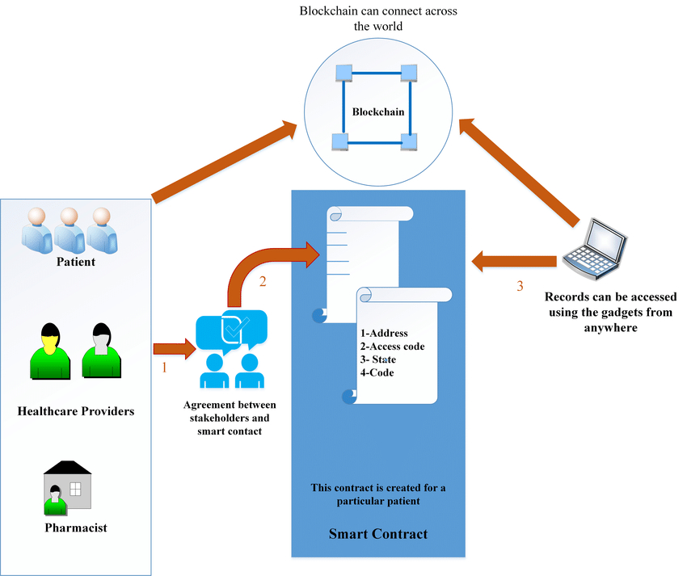
6 Steps Hexagonal Segmented Diagram
Smart Contact
Smart Contacts work together with the blockchain technology and automatically generates
to its full potential.
This is a software program that controls assets that are digital.
Bitcoin is served as the foundation for Smart Contacts.
It is the logical codes that move electronic assets when occurred at intervals.
The Blockchain always offers the execution in a manner of decentralization.
Smart Contacts are referred as the components to Blockchain platform of next generation.
This is a term mainly used to describe the capability to facilitating and enforcing the
agreement on the basis of their payment.

Slide 12
6 Steps Hexagonal Segmented Diagram
Solidity
Solidity is a statically typed, contract-oriented, high-level language for implementing smart contracts on the Ethereum platform.
Smart contracts are programs that are executed inside a peer-to-peer network where nobody has special authority over the execution, and thus they allow to implement tokens of value, ownership, voting, and other kinds of logic.
Solidity was influenced by C++, Python and JavaScript and is designed to target the Ethereum Virtual Machine (EVM).
Solidity is statically typed, supports inheritance, libraries and complex user-defined types among other features.
With Solidity you can create contracts for uses such as voting, crowdfunding, blind auctions, and multi-signature wallets.
06

